Slide 1
Algorithms and Data Structures TEB1113/TFB2023 - may 2025
LAB TA: Reeyan afzal

Slide 2

LAB – 9 graphs

Slide 3
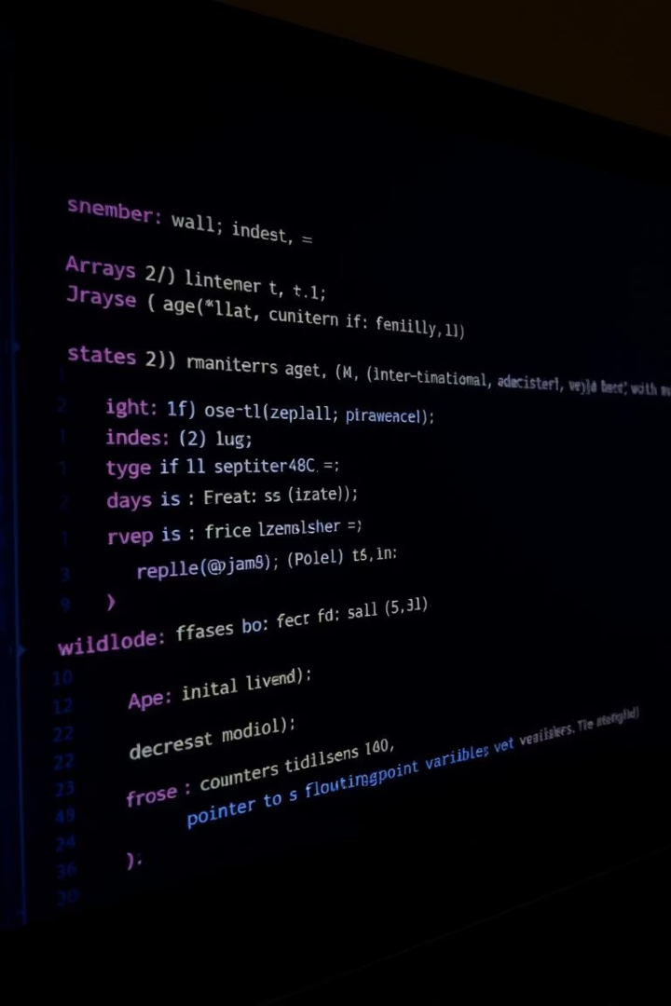
Objectives for lab-9
Understand the properties of graph data structures.
Learning different types of graph representations.
Implementation of DFS and BFS traversal.

Slide 4

Brief history
A Graph 𝐺(𝑉, 𝐸) can be represented by a set of vertices denoted by 𝑉 and edges 𝐸. A graph is a collection of set of vertices connected by edges.
Vertices of the graph are called nodes, and these nodes have a data field that stores the data.
The difference between a tree and a graph is tree is acyclic whereas a graph may contain a cycle. Many real-world problems can be represented using a graph, and those problems can be solved using various graph algorithms.
For example, let’s say we want to find the shortest distance between two cities, we can represent every city as a node of a graph and the edge as the distance between two cities.
After this representation, we can apply the shortest path finding algorithm of the graph to determine the shortest path between two cities.

Slide 5

Brief history
𝑉 = {𝐴, 𝐵, 𝐶, 𝐷, 𝐸}
𝐸 = {(𝐴, 𝐵),(𝐵, 𝐸),(𝐴, 𝐷), (𝐴, 𝐶),(𝐶, 𝐷),(𝐷, 𝐸),(𝐵, 𝐷)}

Slide 6
Types of graphs
Directed graph: In a directed graph, edges have a specific direction. Edge (𝑎, 𝑏) and edge (𝑏, 𝑎) have different meanings in the case of a directed graph.
Undirected: In an undirected graph, edges don’t represent a specific direction. Edge (𝑎, 𝑏) and edge (𝑏, 𝑎) are equivalent in the case of an undirected graph.

Slide 7
Representation of Graphs
Graphs can be stored in two ways:
Sequential or Adjacency Matrix Representation
Linked list or Adjacency List Representation

Slide 8
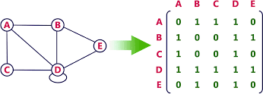
Adjacency matrix Representation
The graph G can be represented in the form of a matrix representation, and the weights associated with the edge from one node (node i) to the other (node j) form the entries (Aij) of the matrix A.

Slide 9

Adjacency list Representation
An adjacency list is used in the linked representation to store the Graph in the computer's memory. It is efficient in terms of storage, as we only have to store the values for edges.

Slide 10
Graph Traversal
The graphs can be traversed using either Breadth-First Search (BFS) or Depth-First Search (DFS). In BFS, we traverse from the root node to the other nodes in a breadth-first manner, using a queue to move to the next node. Depth-first search (DFS) traverses the whole graph depth-wise and uses a stack to get to the next nodes.
𝐷𝑒𝑝𝑡ℎ 𝐹𝑖𝑟𝑠𝑡 𝑆𝑒𝑎𝑟𝑐ℎ∶ 𝐴, 𝐵, 𝐸, 𝐷, 𝐶
𝐵𝑟𝑒𝑎𝑑𝑡ℎ 𝐹𝑖𝑟𝑠𝑡 𝑆𝑒𝑎𝑟𝑐ℎ∶ 𝐴, 𝐵, 𝐶, 𝐷, 𝐸

Slide 11
Spanning tree
A spanning tree of a graph is a subset of the graph covers all the vertices with a minimum number of possible edges. Spanning tree is used to find the minimum path connecting all nodes in a graph.
A spanning tree does not have cycles, and it cannot be disconnected.

Slide 12
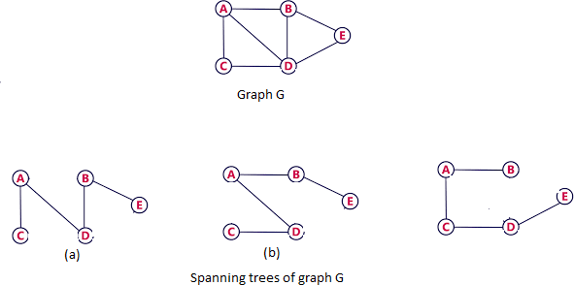
Spanning tree

Slide 13
Lab-task
Implement the adjacency list representation of a graph with m vertices and n edges. Also, check whether a path of a given length exists between any two pairs of vertices or not.
Find the minimum spanning tree of an undirected Graph using a greedy approach.

